Slide 1


Retail Analytics:
Uncovering Sales, Shipping, and Customer Trends in Superstore Data
by Fatin Shahirah

Slide 2


Context
Mohd Gana, CEO of a mid-sized retail company, has observed a rise in customer
complaints related to delayed deliveries. Concerned about the potential impact on customer
satisfaction and business reputation, he is seeking a deeper understanding of the root
causes.
To support this, Mohd Gana has requested a data analysis project to explore patterns in
shipping performance, sales trends, and customer behavior. The goal is to uncover insights
that can help the sales and product teams improve fulfillment processes and better serve
different customer segments.

Slide 3
Big Questions to Explore
🟦
Which products are driving the most sales?
Which shipping methods are leading to delays?
Which customer segments are most profitable?

Slide 4


Dataset Overview
Customers Dataset: Customer ID, Segment
Orders Dataset: Sales, Discount, Profit, Product Category ID, Customer ID, Shipping ID
Products Dataset: Product Category ID, Category, Sub-Category
Shipping Dataset: Shipping ID, Ship Mode, Order Date, Delivered Date, City, State, Postal Code

Slide 5

Key Columns Used
Sales – used to calculate product and category performance
Profit – to determine segment profitability
Delivery Days – computed from Order Date and Delivered Date
Timing_Label – classified as Early, On Time, Late
Ship Mode – used to assess shipping performance
Segment – customer type linked to profitability

Slide 6
Relationship Explored
Product Sub-Category vs. Total Sales
Product Category vs. Total Sales
Ship Mode vs. Delivery Timing
State vs. Delivery Timing
Customer Segment vs. Profit

Slide 7
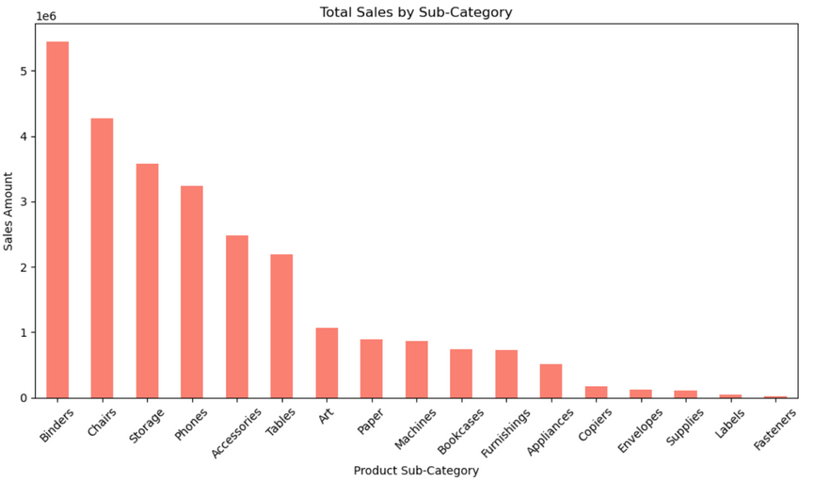
Product Sales Performance
Top-performing sub-categories: Binders: Highest sales
Chairs, Storage, Phones: Also high performers
Mid-tier sub-categories: Accessories, Tables, Art, Paper, Machines.
Low-performing sub-categories: Fasteners, Labels, Supplies, Envelopes, Copiers

Slide 8
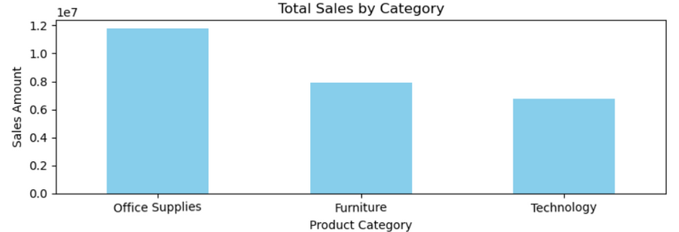
Product Category Sales Performance
Office Supplies: Highest overall sales.
Furniture: Second
Technology: Third
Note: Even though Technology has high-ticket items (like Phones), it’s third because other sub-categories may be fewer or less frequently sold.

Slide 9
Data Insights
High Sales, High Category:
• Binders, Chairs, Storage, Phones are likely the main contributors to their respective categories.
• Office Supplies dominates because it contains multiple high-selling sub-categories.
Low Sales Sub-Categories:
• Fasteners, Labels, Envelopes, Copiers are contributing very little. These may not be worth pushing unless they serve a niche purpose or support high-profit margins.

Slide 10
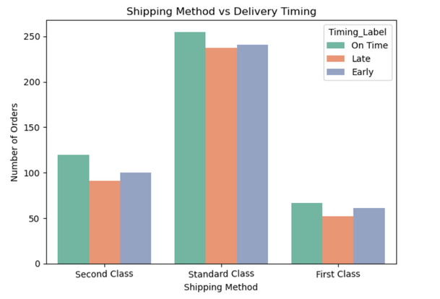
Shipping Method Performance
Standard Class
• Most popular shipping method with the highest number of orders .
• Orders are almost evenly split among On Time, Late, and Early deliveries.
• This suggests variability in delivery timing.
Second Class
• Moderate usage
• Slightly more orders delivered On Time.
• Late and Early deliveries are fairly balanced but lower than “On Time”.
First Class
• Least used shipping method
• Similar pattern as Second Class, with a small preference toward On Time and Early deliveries.
• Lowest number of Late deliveries.

Slide 11
Data Insights
1. Standard Class dominates in volume but may need review due to high variability in delivery timing .
2. Second Class and First Class show better delivery consistency, with a slight preference toward on-time or early deliveries.
3. First Class, although least used, has fewer late deliveries, suggesting it may be more reliable.

Slide 12
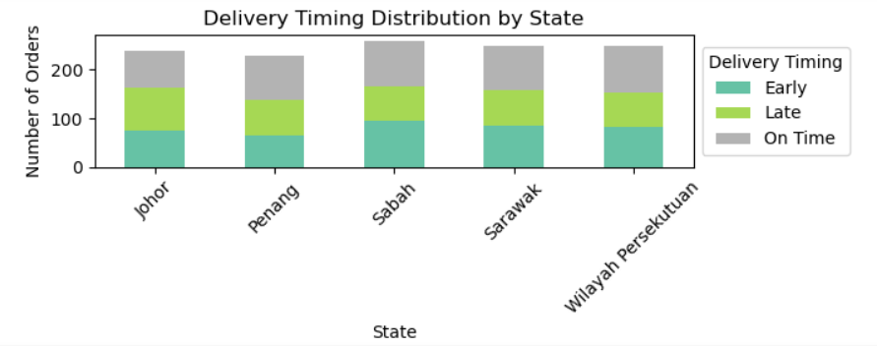
State-Level Delivery Issues
All states have similar total order volumes
No state shows a dominant proportion of on-time deliveries — each state has a noticeable share of late deliveries.
States like Sabah and Sarawak appear to have relatively higher proportions of late deliveries compared to Peninsular states.

Slide 13
Data Insights
1. Sabah and Sarawak are facing more frequent delivery delays likely due to:
• Geographic remoteness
• Limited access to warehouses or shipping infrastructure
2. Late deliveries are a widespread issue, even in urban or centralized areas like Wilayah Persekutuan, indicating possible:
• Warehouse inefficiencies
• Unreliable carrier services
• Overpromising in estimated delivery windows

Slide 14
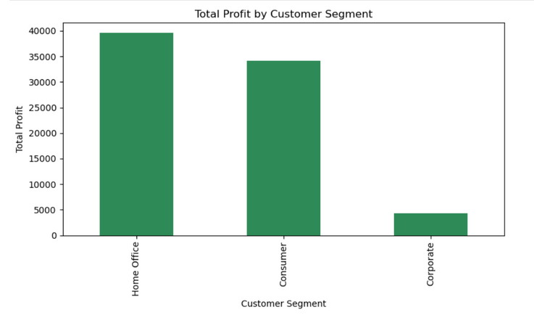
Customer Segment Profitability
Home Office
• Highest total profit, around $40,000.
• This segment is the most profitable, suggesting strong buying behavior or high-margin purchases.
Consumer
• Second highest, generating just under $35,000 in total profit.
• Still a very profitable segment, though slightly less than Home Office.
Corporate
• Lowest profit, under $10,000.
• Represents a major gap compared to the other two segments.

Slide 15
Data Insights
1. Home Office is the most valuable segment — it deserves the most attention and retention efforts.
2. Consumer is also very profitable and likely has high volume — could be a good focus for upselling/cross-selling.
3. Corporate significantly underperforms — either due to low volume, tight margins, bulk discounts, or poor engagement.

Slide 16
Conclusion
Data-driven decisions can optimize product focus, shipping strategies, and customer targeting.
This analysis lays the foundation for more efficient operations and improved customer satisfaction.

Slide 17
Thank You

